Slide 1
Processor Arch: Pipelined
Memory Hierarchy
MADE BY: Zhong Zhineng & Song Yixin

Slide 2
Processor Arch: Pipelined

Slide 3
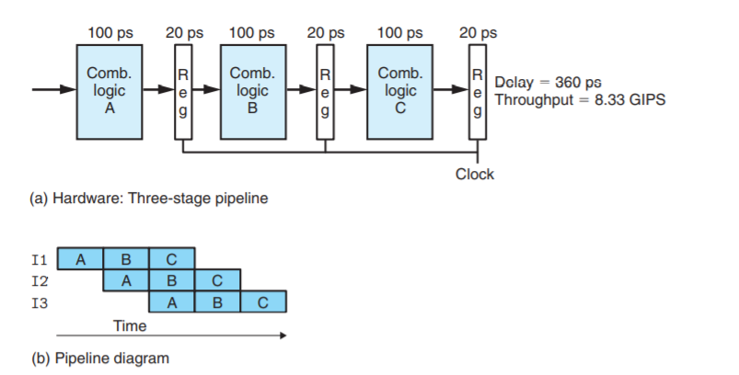
Pipeline Basics
Throughput and latency change

Slide 4
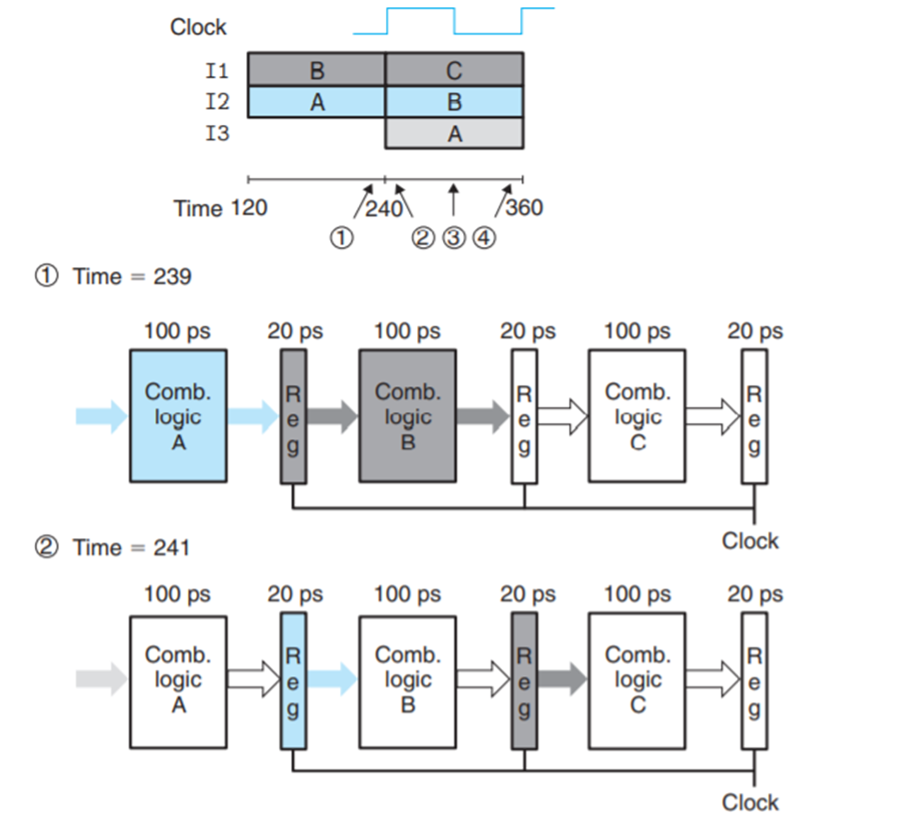
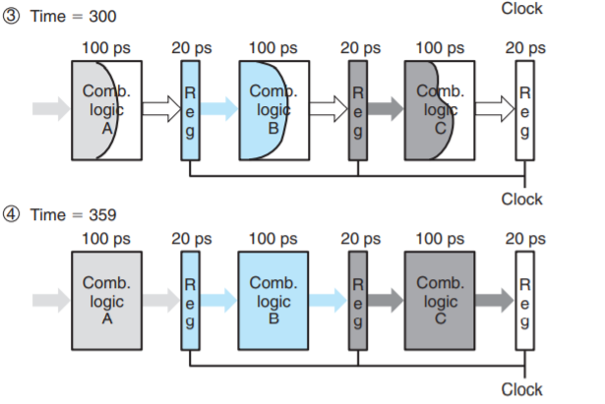
Pipeline Basics
Critical moments

Slide 5
Pipeline Basics
Limitations of pipelining
Nonuniform partitioning
Decreasing returns to pipeline depth
Stages
AMD Zen2(3th Gen Ryzen): 19 stages
Intel Ice Lake(10th Gen core): 14-19 stages

Slide 6
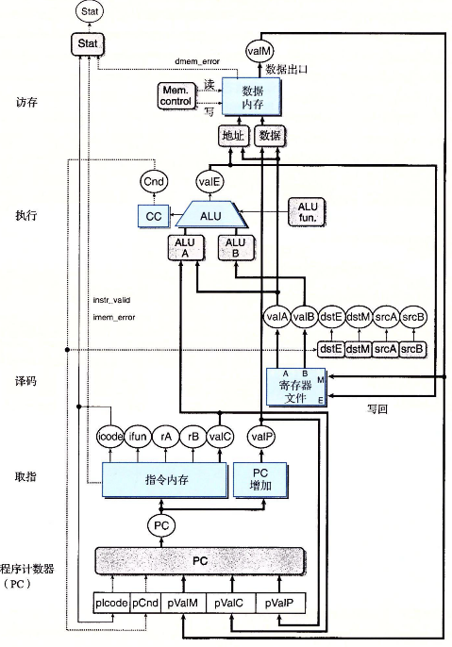
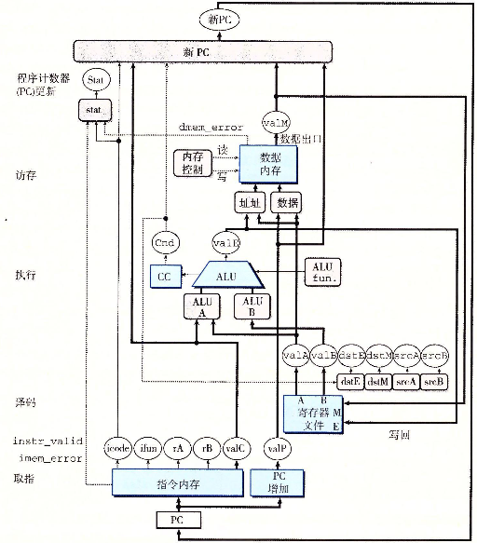
SEQ->SEQ+

Slide 7
SEQ->SEQ+
Circuit retiming
PC update stage
No hardware PC registers

Slide 8
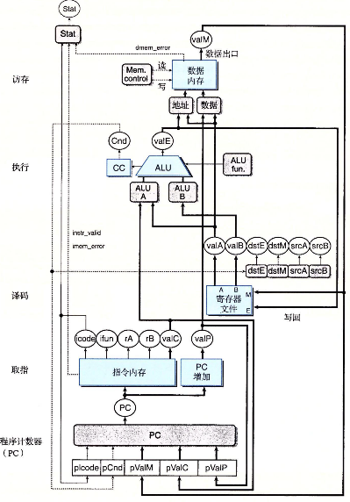
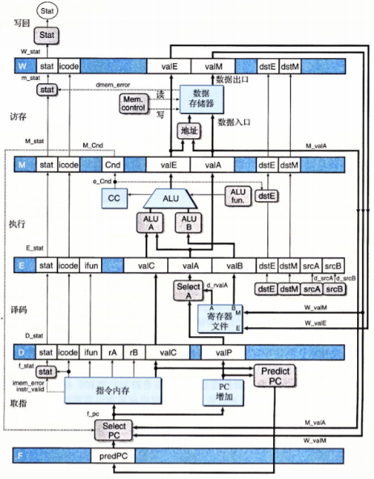
SEQ+->PIPE-

Slide 9
SEQ+->PIPE-
Adding pipeline registers
Select PC
Select A: Since valP is only used in the Memory period of call and in the Execute period of jXX and both of them do not need valA, Select A module is used to reduce the number of registers.

Slide 10
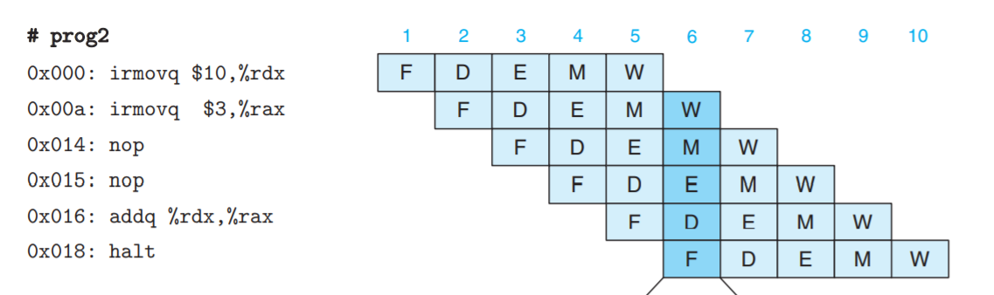
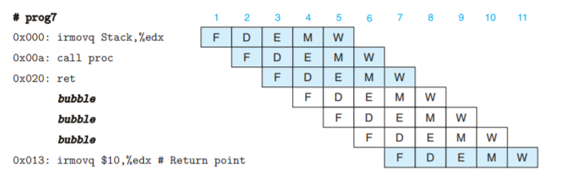
Problems: Data/Control Dependency
Data hazard
Control hazard

Slide 11
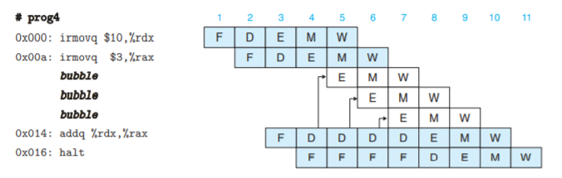
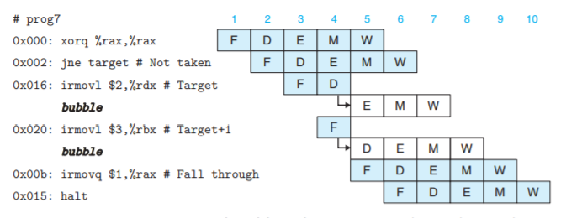
A Simple Solution: Bubbles and Stalls
Handling
data
hazard
Handling
control
hazard

Slide 12

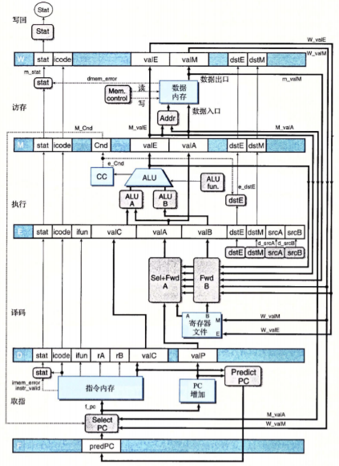
Another Solution: Forward
Need the data that has not written back to the registers when decoding.
Principle: Try to use forward. If failed, use stall.
Sel+Fwd A
Fwd B

Slide 13
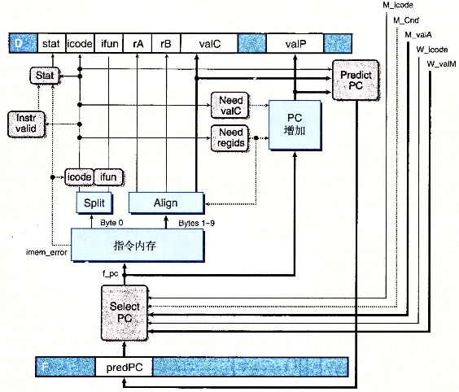
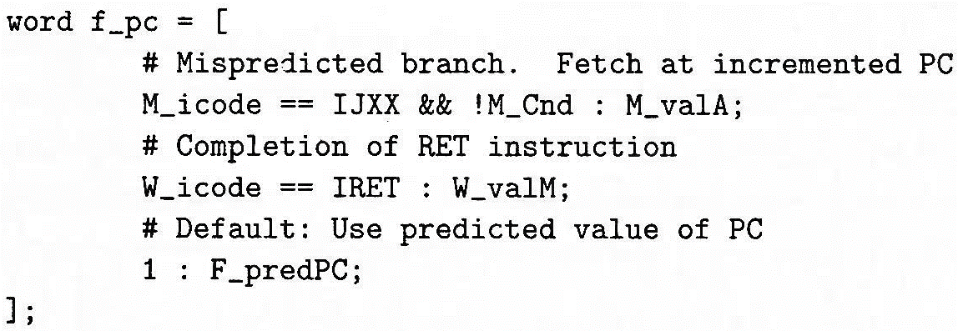
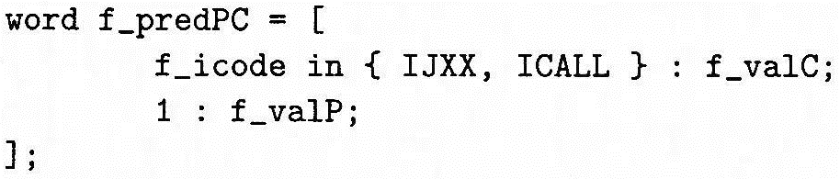
Modified HCL: Select PC & Fetch
HCL:

Slide 14
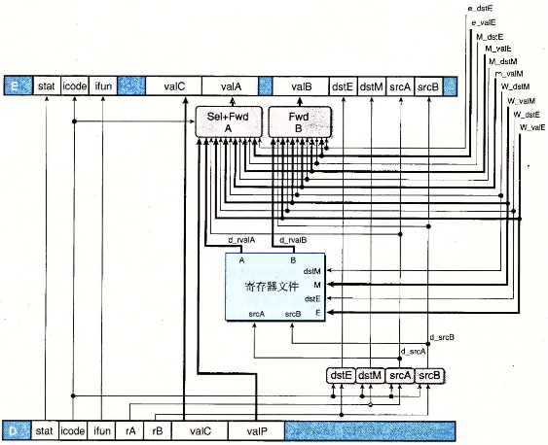
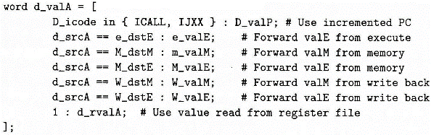
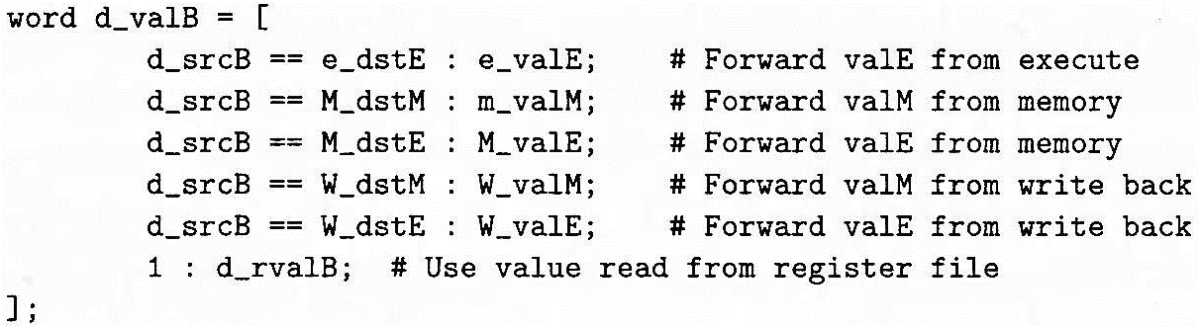
Modified HCL: Decode & Write back
HCL:
Pay attention to the choice order!

Slide 15
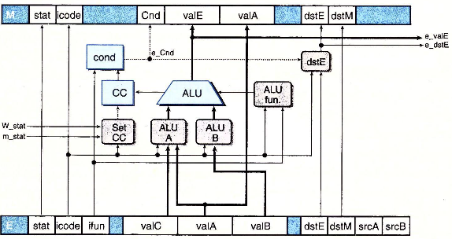
Modified HCL: Execute
HCL: left out

Slide 16
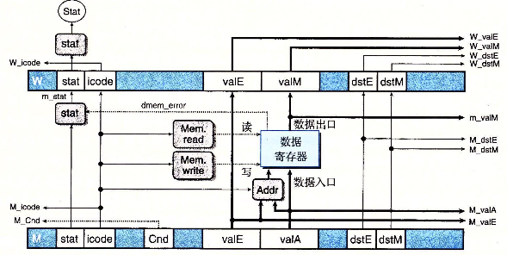
Modified HCL: Memory
HCL: left out

Slide 17
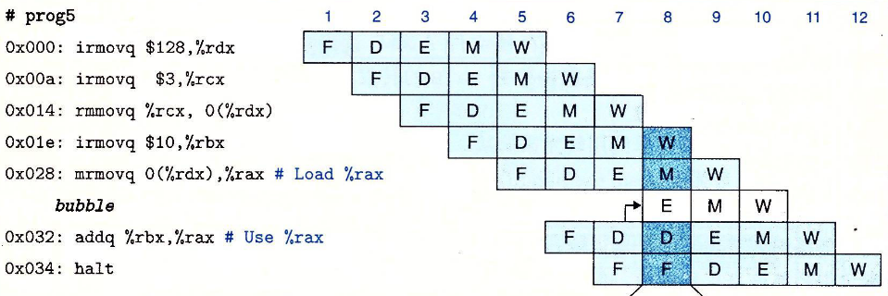
Hazard: Load/Use
You cannot only use forwarding to solve all the problems…
Last instruction reads data from memory to a register, and present instruction needs the data in this register.
Must stall and insert a bubble, then forward from memory stage.

Slide 18
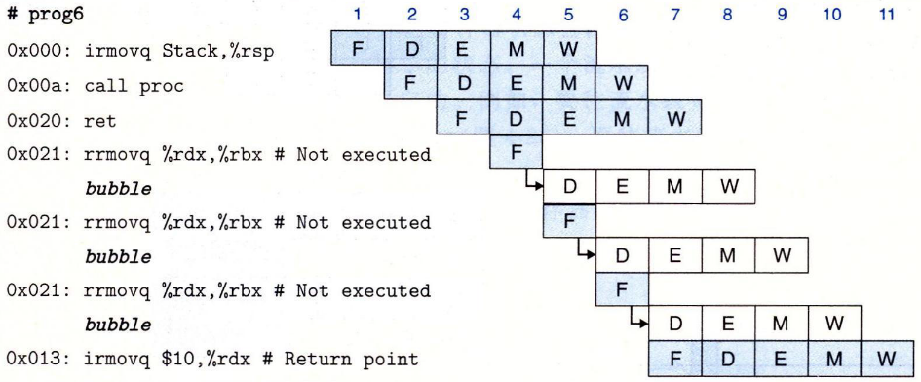
Hazard: ret
The PC of the next instruction of ret will be known until memory stage.
Insert three bubbles.

Slide 19
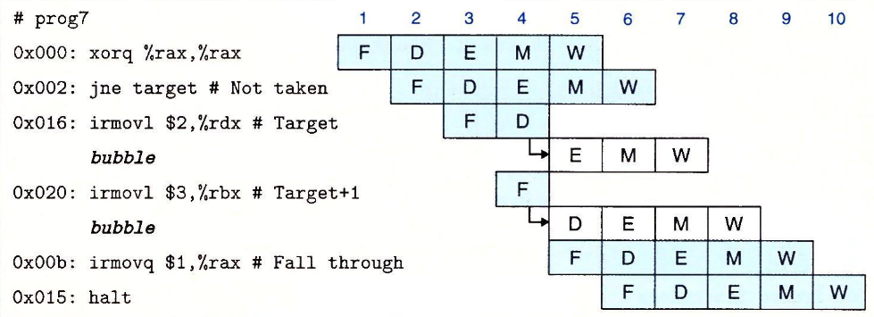
Hazard: Branch Misprediction
After Execute stage, the right branch will be known.
Insert two bubbles.

Slide 20
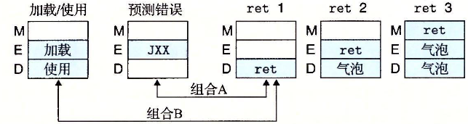
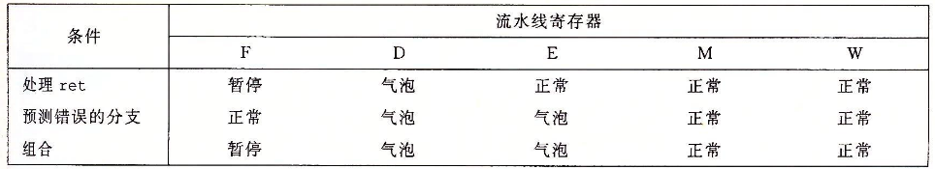
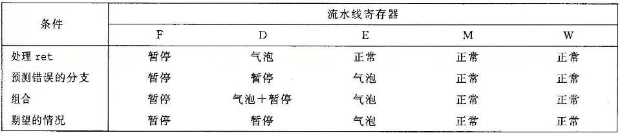
Hazard Combination

Slide 21
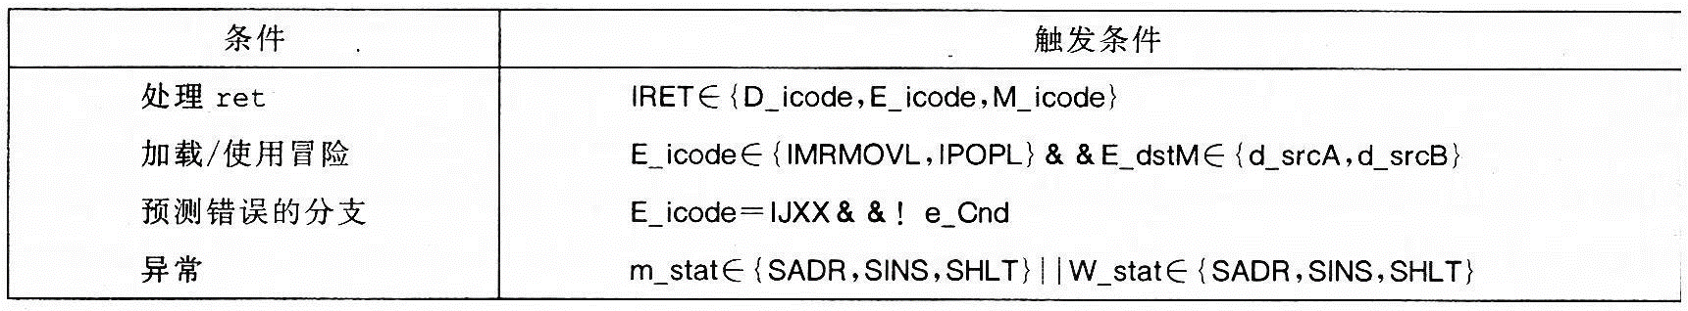
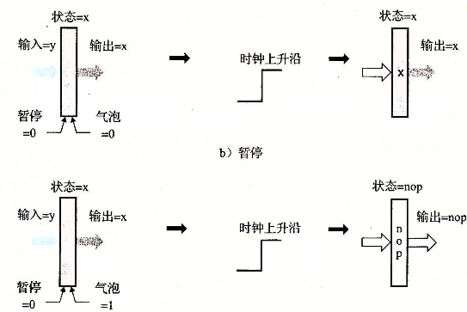
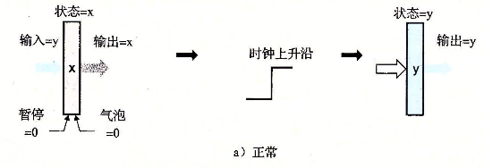
Hazard Detection & Control

Slide 22
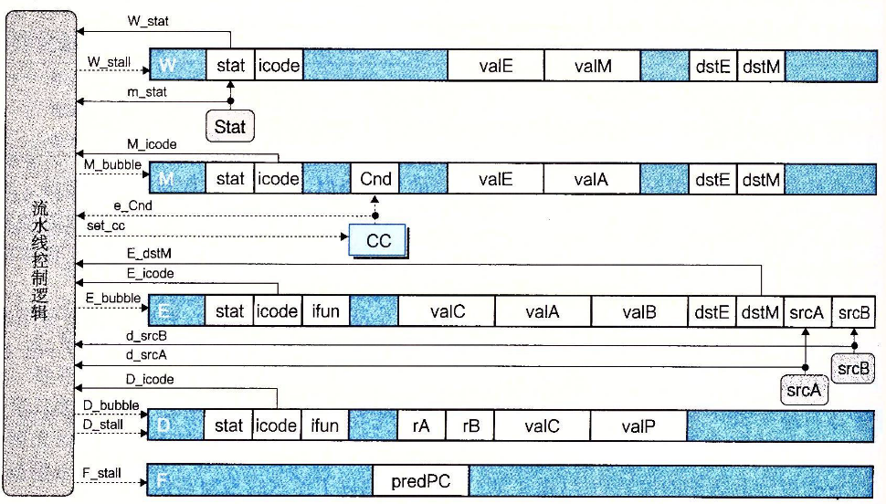
Implementing Pipeline Control

Slide 23
Memory Hierarchy

Slide 24
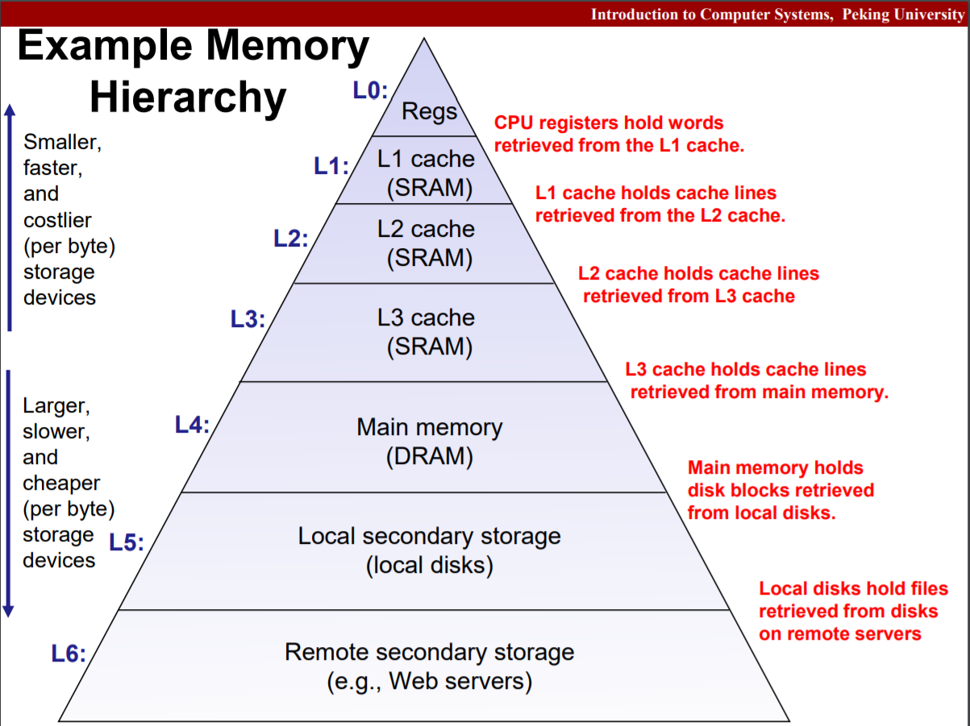
Example

Slide 25
Storage Technology
RAM: SRAM & DRAM
Disk
Bus structure

Slide 26
RAM
Random Access Memory (RAM)
Volatile, expensive, compared to hard disk
SRAM versus DRAM
SRAM doesn’t need refresh
faster and stable, more expensive
used as cache memories
DRAM
higher density, lower power consumption
used as main memory

Slide 27
DRAM: Access
Row Access Strobe (RAS)
Column Access Strobe (CAS)
Memory module: Read & Write a word
FPM DRAM, SDRAM, DDR SDRAM

Slide 28
ROM
nonvolatile, compared to RAM
PROM: only programmed once
EPROM
EEPROM -> flash memory
firmware: stored in ROM

Slide 29
BUS
Bus transaction: read and write
System bus: connecting CPU and I/O bridge
Memory bus: connecting I/O bridge and main memory
I/O bus: disk, graphic card and other buses

Slide 30
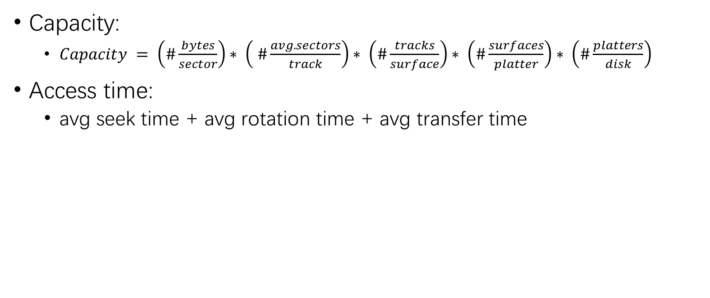
DISK
Capacity:
$Capacity = \left(\#\frac{bytes}{sector}\right)∗ \left( \#\frac{avg. sectors}{track}\right)∗ \left(\#\frac{tracks}{surface}\right)∗ \left(\#\frac{surfaces}{platter}\right)∗ \left(\#\frac{platters}{disk}\right)$
Access time:
avg seek time + avg rotation time + avg transfer time

Slide 31
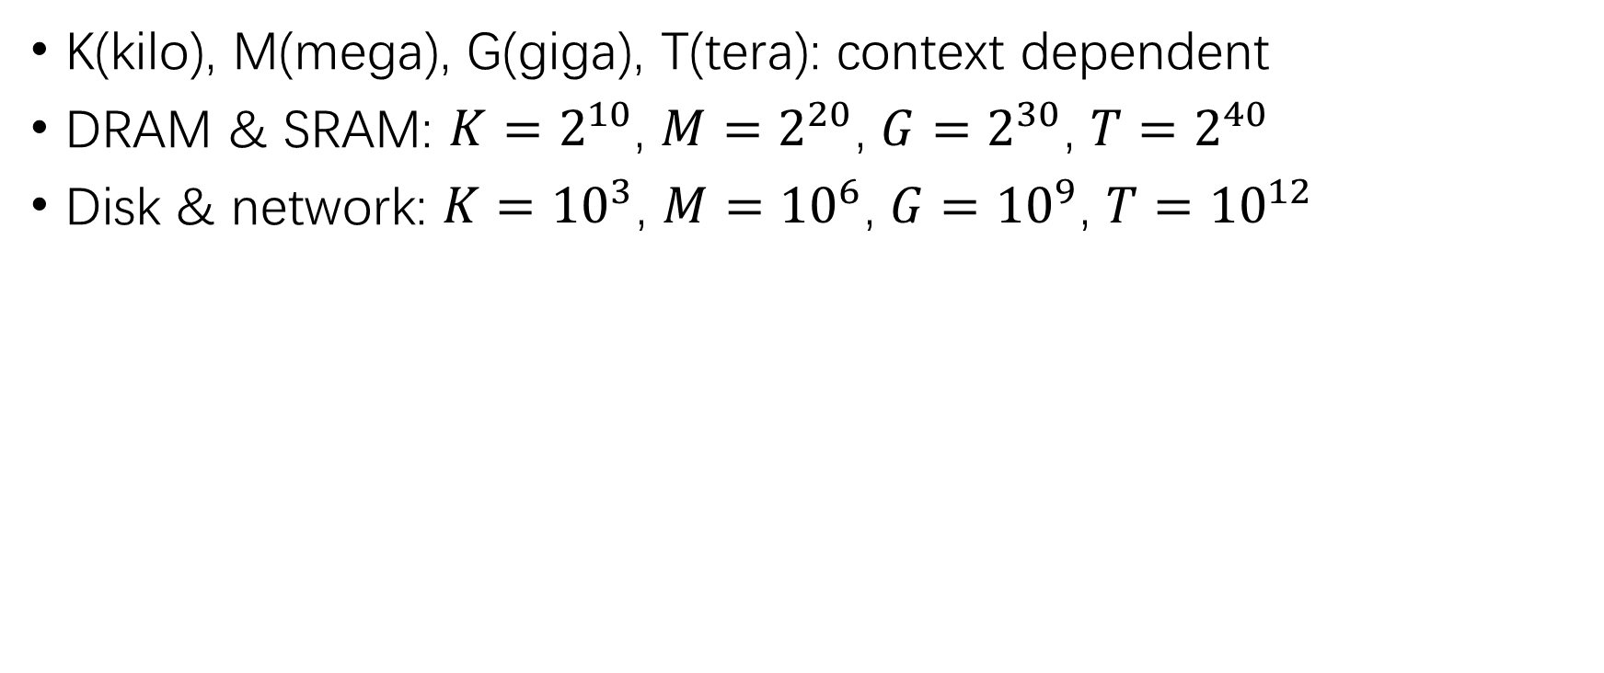
Unit Conversion
K(kilo), M(mega), G(giga), T(tera): context dependent
DRAM & SRAM: ${K=2}^{10}$, ${M=2}^{20}$, ${G=2}^{30}$, ${T=2}^{40}$
Disk & network: ${K=10}^{3}$, ${M=10}^{6}$, ${G=10}^{9}$, ${T=10}^{12}$

Slide 32
SSD
Solid State Disk (SSD)
Sequential access faster than random access
Write slower than Read
Modifying a block page requires full page erasure and copy

Slide 33
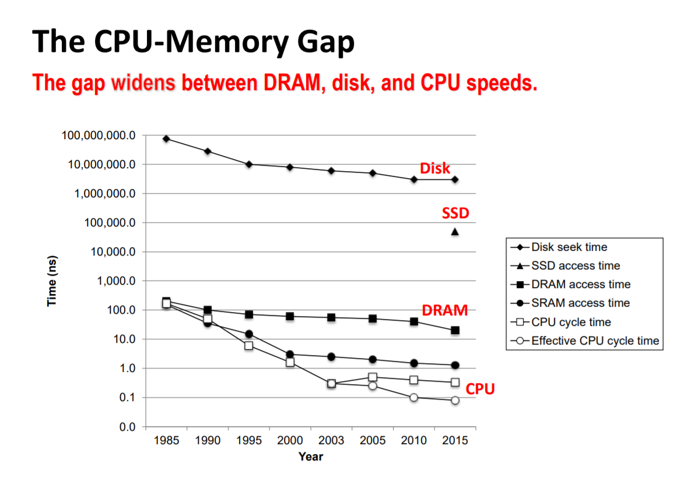
Developing Tendency

Slide 34
Locality
Temporal locality
Spatial locality
Data-access: temporal locality or spatial locality:
The smaller the step length, the better the spatial locality.
Repeating references to the same variable has the temporal locality.
Instruction-fetch: both locality:
The smaller the loop body and the more the number of iteration, the better the locality.

Slide 35
Thanks for listening.

